Slide 1
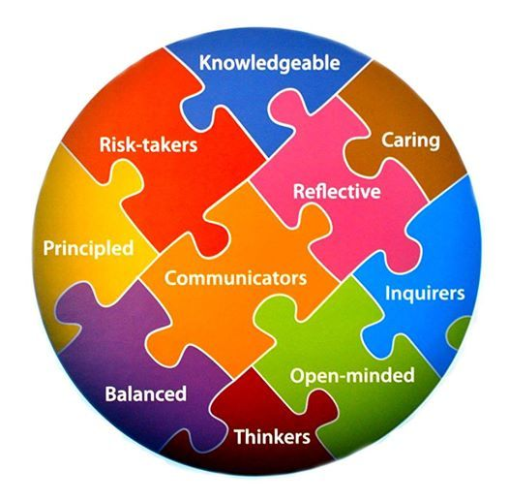
Welcome to the 2020-2021 School Year!
Prospect is an IB Candidate School. Our mission goal is for students to become life-long learners who are global minded citizens aims to inspire students to become lifelong learners who are globally minded. We create opportunities for students to be active inquirers, thinkers and contributing members of society.
How will we accomplish this goal? Together as a community!

Slide 2


Students Engage in the 4 Transdisciplinary Themes through…

Slide 3
Modeling and reinforcing the Learner Profile attributes at school and at home.

Slide 4
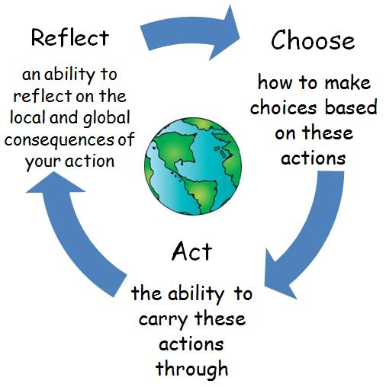
Taking Action throughout our Learning Experiences

Slide 5
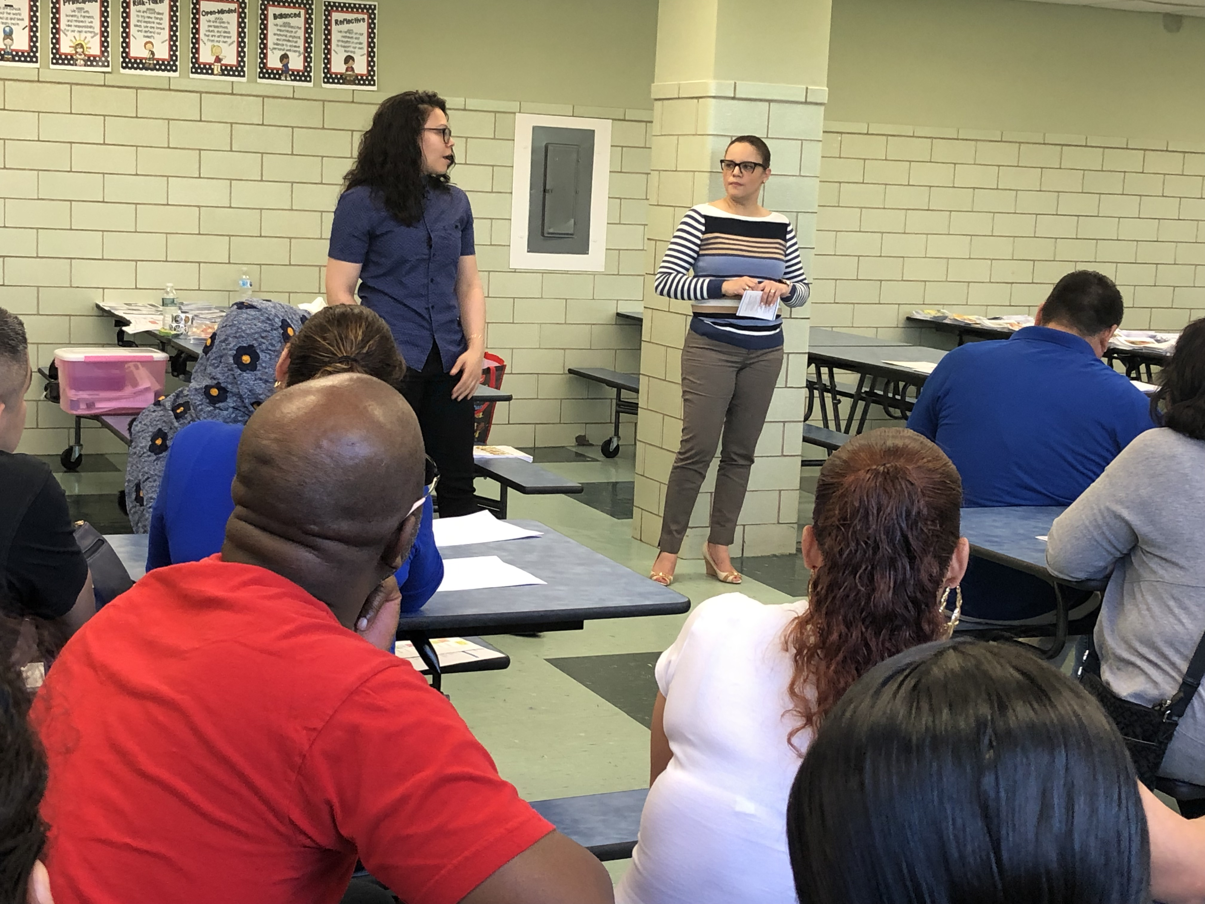
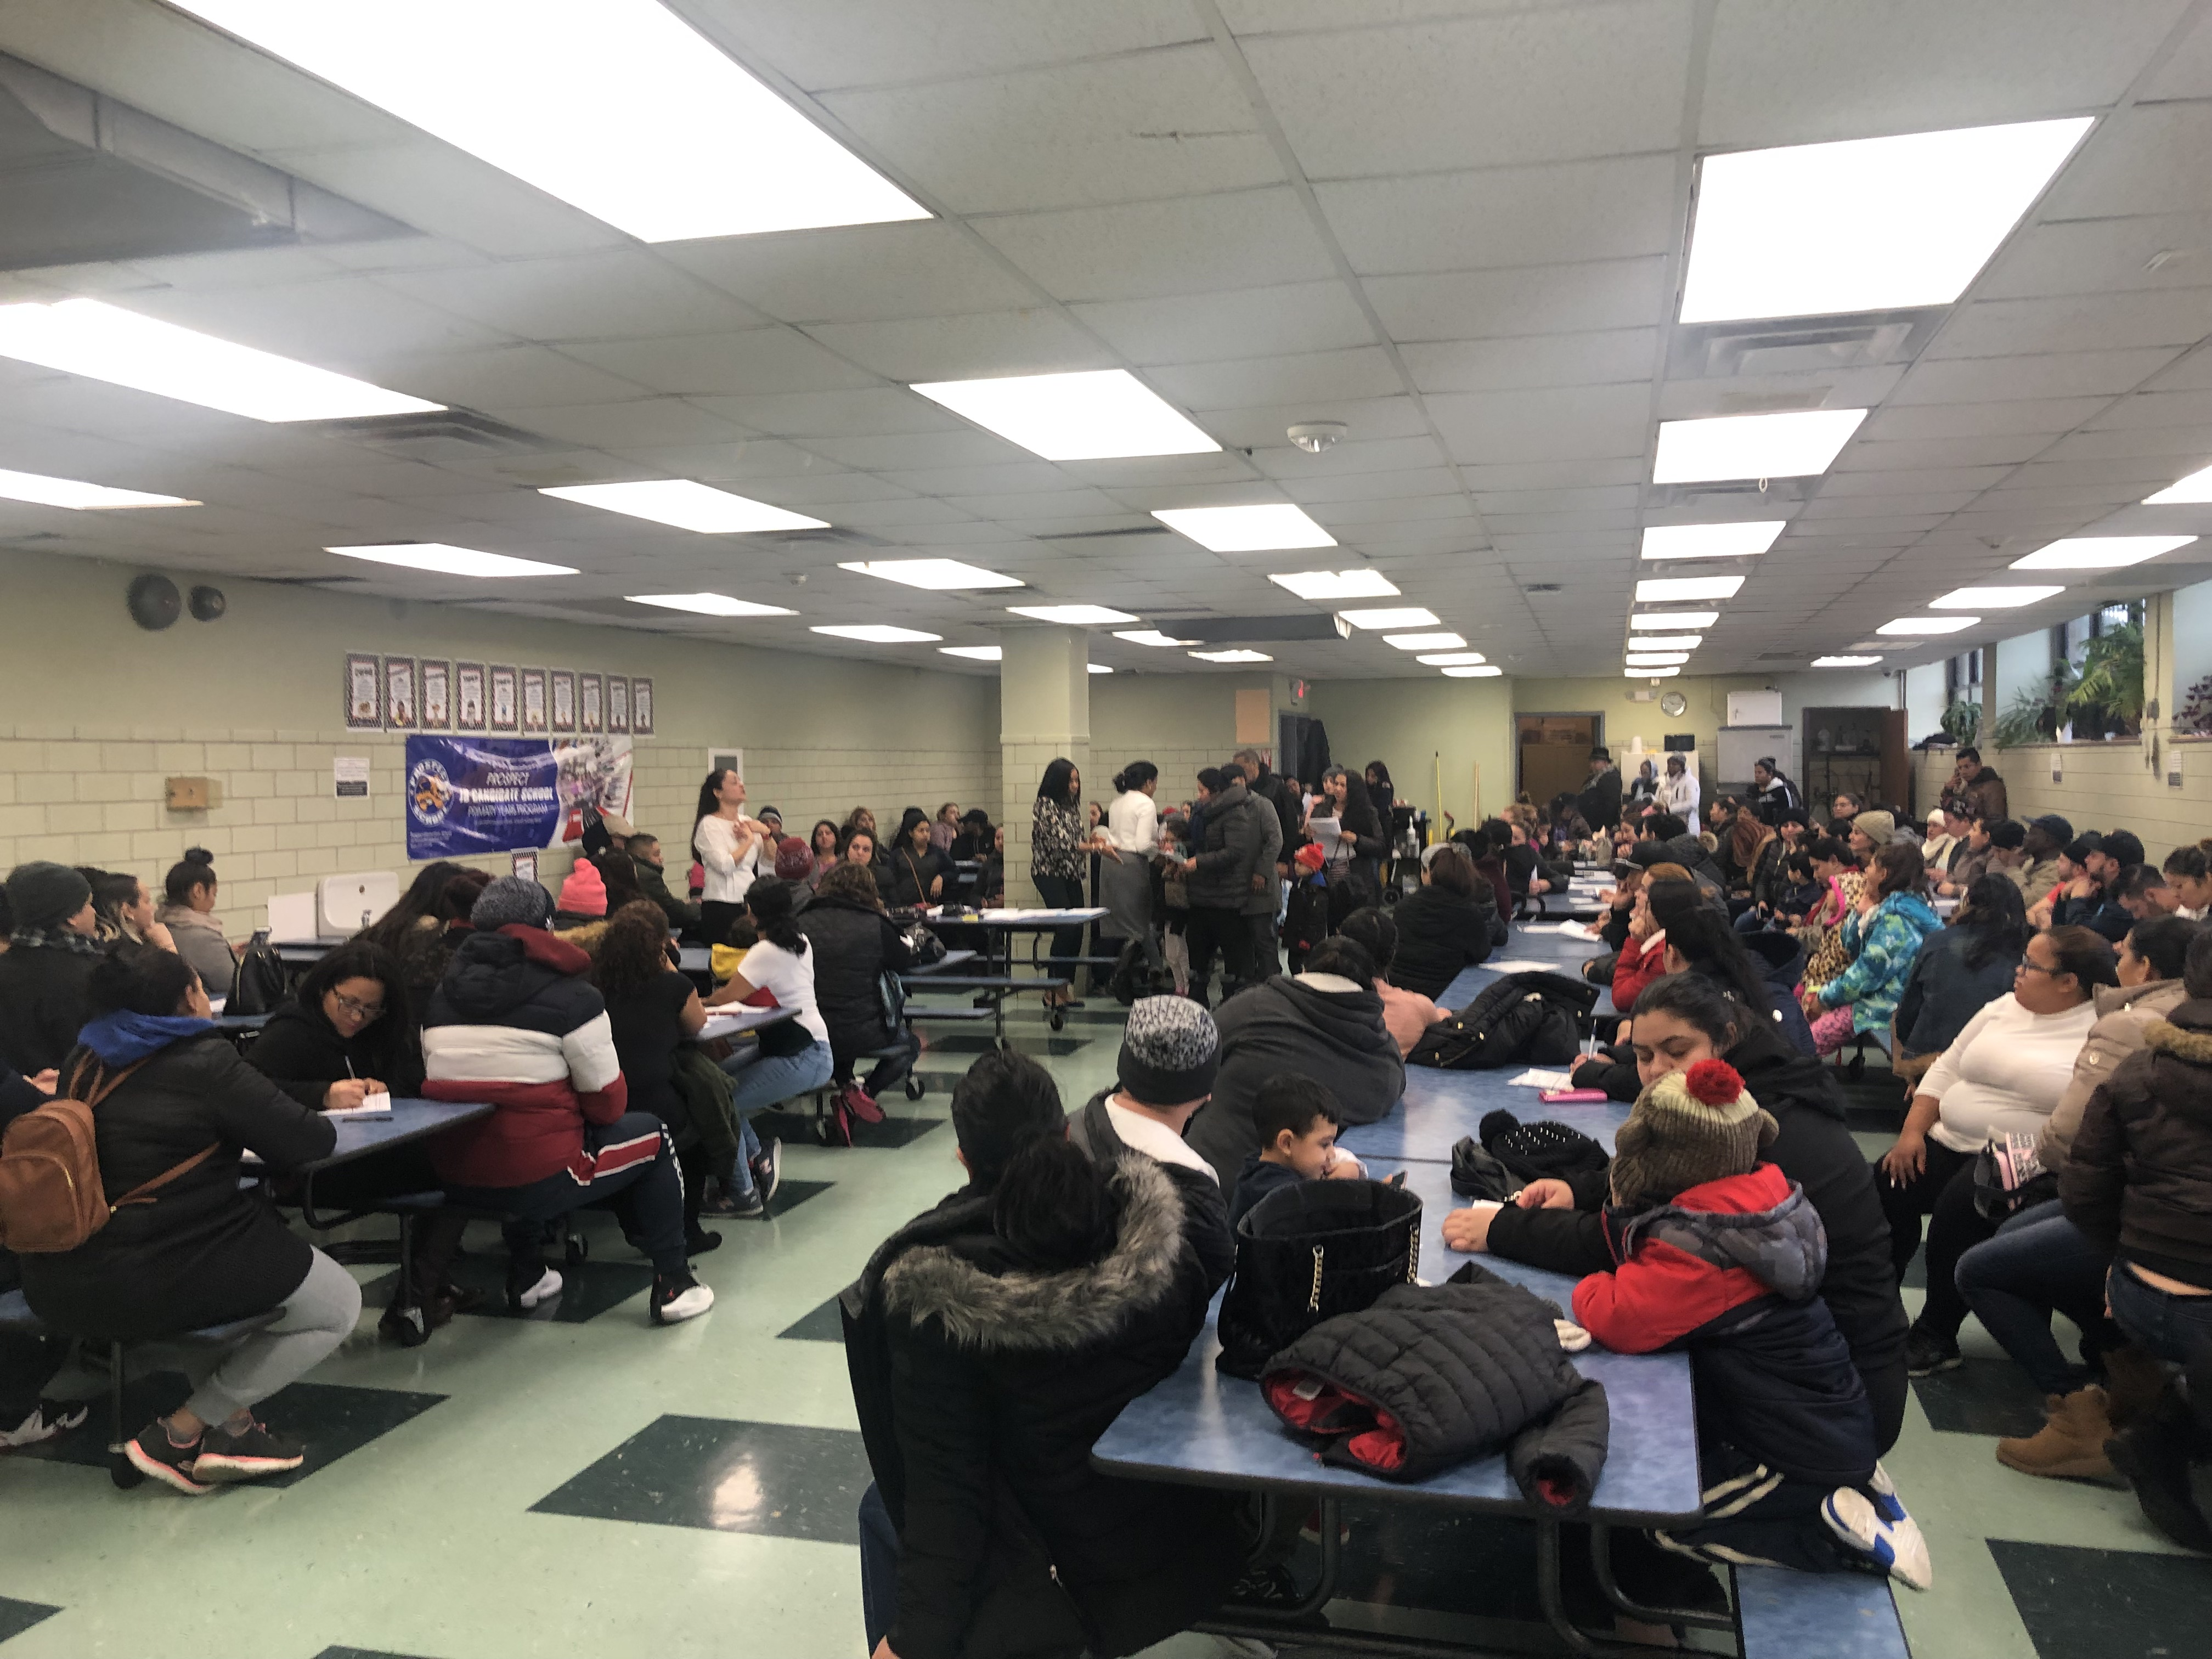
Attend Parent Meetings and Workshops
PTO/Parent Workshop

Slide 6
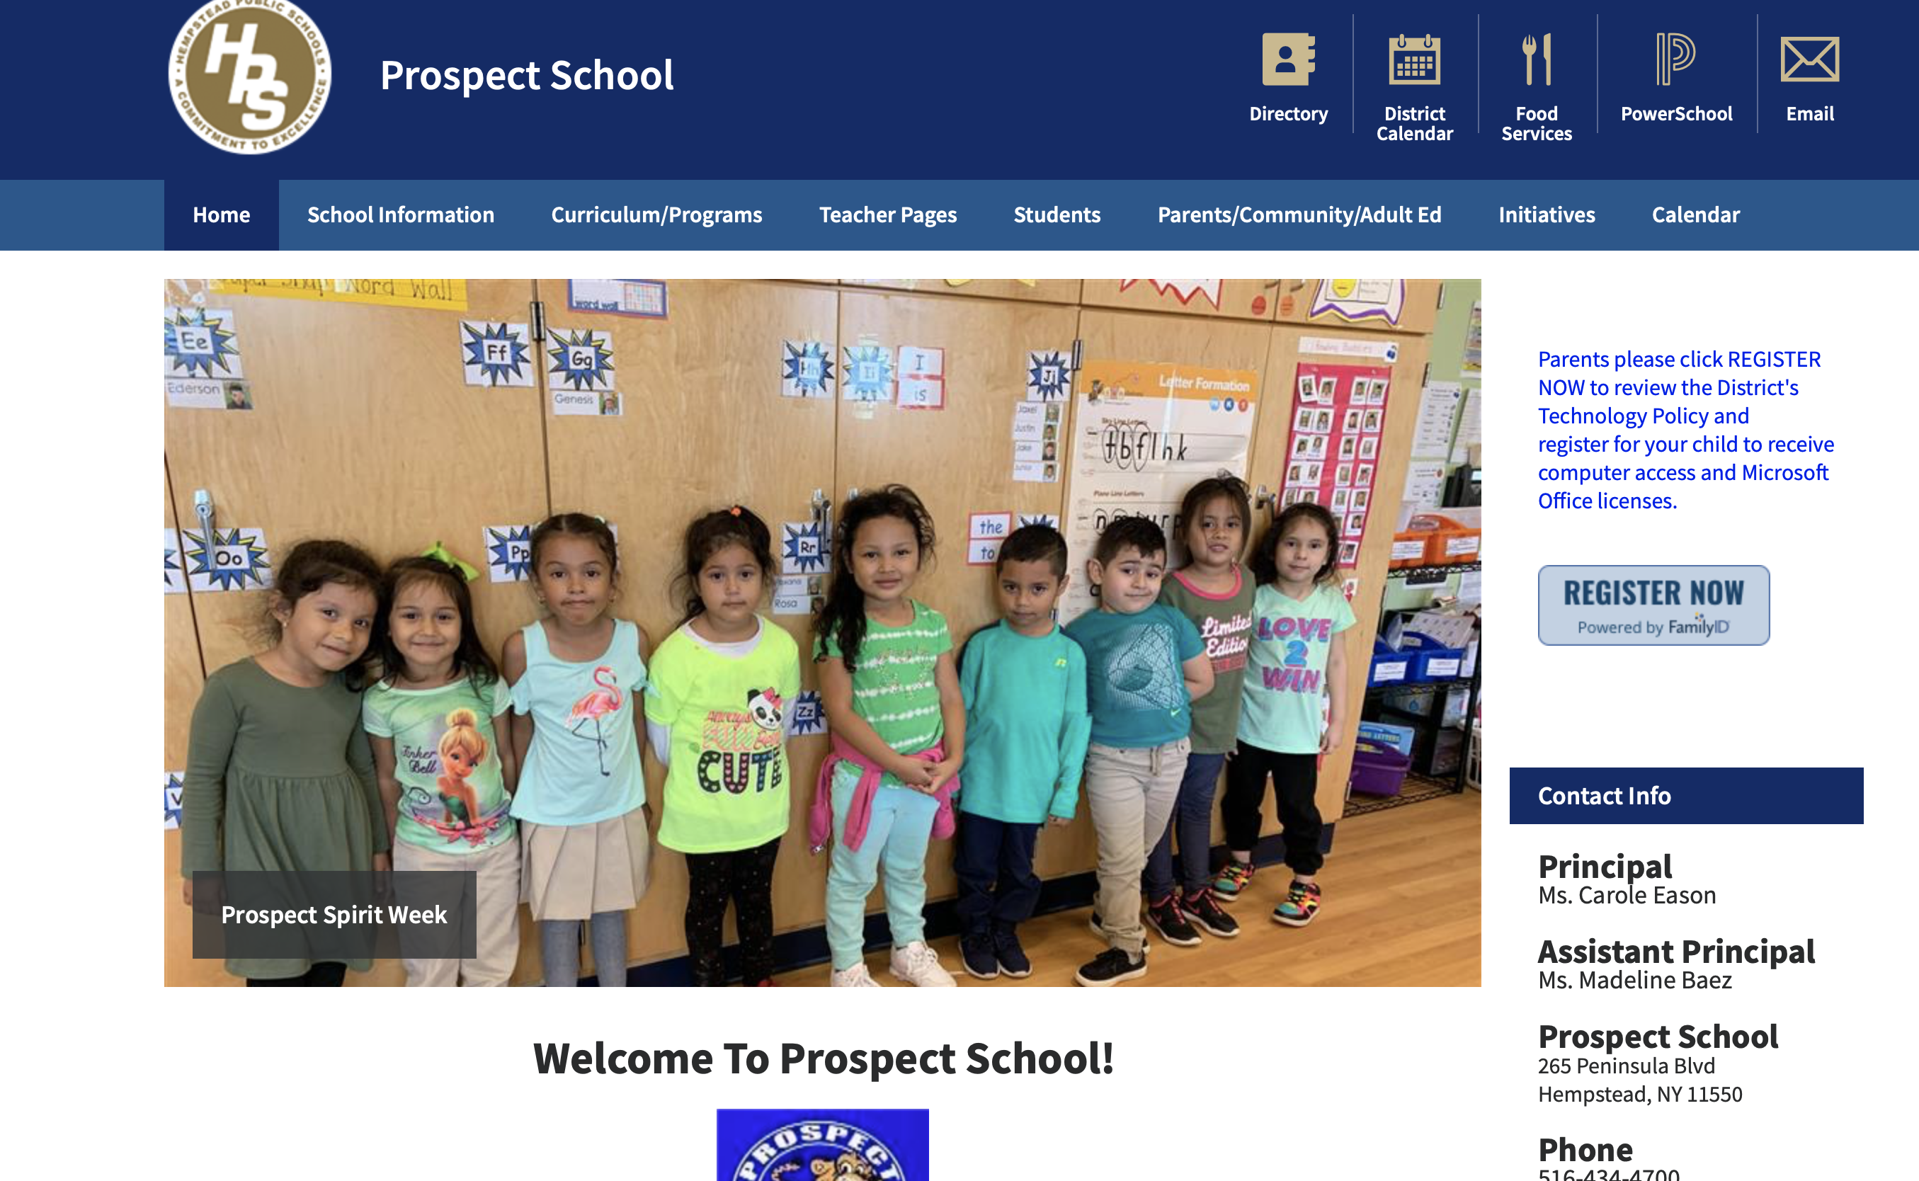
Visit our School Website to Stay Informed

